Slide 1
Statistics & Spreadsheets
Intermediate Answer
Syihab Agung Satriotomo Berlin - Team 4

Slide 2
Milestone 1

Slide 3
Business Understanding
Question
What is the core business problem faced by Luxura?
Answer
Based on Background brief, that we have 2 Problem in Luxura Business that need to analyze, these are the problems :
From Information that I understand we could insight on which brand that should be Prioritize Adibi, Balena, or Celinna so we can give company recommendations
To test on the Purchase Performance based average product revenue on each brand that consist purchase information and identity of each user who has made a purchase to Luxura in the last quarter of 2022

Slide 4
Business Understanding
Question
B. Considering the data that you have, how do you think the data can help you answer the business problem?
Answer
To Understand customer purchase performance by analyzing purchase data by total quantity of order, amount spent on brand, and etc.
Analyzing data by comparing X and Y on Campaign Data we can compare which brand that dominating in the last quarter of 2022.
By knowing Age, Income, Settlement type Total Number of Order, Total quantity of order, and each brand amount spent we could Prioritize which brand or group we can focus on.

Slide 5
Business Understanding
Question
C. What is/are the statistics that you think is/are best to answer business problems in point A?
Answer
Business Problem: we could insight on which brand that should be Prioritize Adibi, Balena, or Celinna so we can give company recommendations
  Proposed statistics: We may use total average, sum or median on customer purchase identity (amount on spent, Age, Settlement type, etc). Then we could do compare on descriptive statistics to understand which brand differences predominate.
Business Problem: To test on the Purchase Performance based average product revenue on each brand that consist purchase information and identity of each user who has made a purchase to Luxura in the last quarter of 2022
  Proposed statistics: We could compare the average product revenue of total amount of spent each brand by campaign

Slide 6
2. Clean Up The Data
Question
Remove rows and column with missing data
Answer
Removing Brand Preference column because the missing data is reaching about 90% of the total data
In sex column we remove 3 rows, delete 3 rows
In Marital status column we remove 2 rows, delete 2 rows
In Education column we remove 1 rows, delete it since it has no effect
In settlement type column we remove 1 rows
In Income column we remove 3 rows
In Total Number of Order column we remove 2 rows
In Total quantity of order column we remove 2 rows
In Adibi Quantity of Order column we remove 2 rows
In Balena Quantity of Order column we remove 1 rows
In Celina Quantity of Order column we remove 1 rows
We Remove Education column because it doesn’t effect on Total quantity of order and Total number of order
All of above Column that has missing data is consist on rows 152, 315, and 411 so we only delete 3 rows.

Slide 7
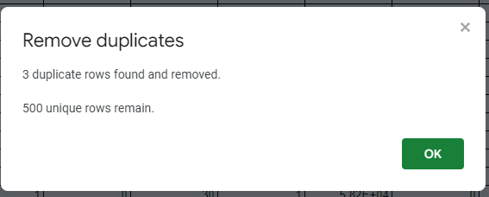
2. Clean Up The Data
Question
B. Remove rows with duplicated price
Answer
Duplicate data has been remove by using Data > Data Cleanup > Remove Duplicates

Slide 8
2. Clean Up The Data
Question
C. Change data type of columns that is not suitable
Answer
In Income column we formatting the data from scientific to US dollars currency
In Amount Spent on Adibi, Balena, and Celinna column we formatting from numbers into thousand of dollar currency
In Promotion Adibi, Balena and Celinna column we change it to Percentage(%) format
Reasoning
Since we want to calculate each column we change the format each column into number so it would be easier to read and calculate.
In Promotion Adibi, Balena and Celinna we used Number format so it could easier to read and calculate.

Slide 9
3. Descriptive Analytics
Question
Create Statistical measurement to know the data distribution
(Insert Google Sheet Link specific page here)
Answer
https://docs.google.com/spreadsheets/d/1GBEL6Gwa-K5rHSN4oRl1Sw3Hioik5ECUVYWYgl7RULA/edit#gid=1241161943
https://docs.google.com/spreadsheets/d/1GBEL6Gwa-K5rHSN4oRl1Sw3Hioik5ECUVYWYgl7RULA/edit#gid=596024240
https://docs.google.com/spreadsheets/d/1GBEL6Gwa-K5rHSN4oRl1Sw3Hioik5ECUVYWYgl7RULA/edit#gid=95839343

Slide 10
3. Descriptive Analytics
Question
B. Eliminate outliers data based on column “Total Number of Order” and “Total Quantity of Order”
Answer
Based on the data outliers on “Total Number of Order” column for the lower outliers was -1 and upper outliers was 7, So there is no lower and upper outliers data in this column (check at the Sheet Descriptive Statistics1, and check at sheet cleaned with eliminate outliers).
Based on the data outliers on “Total Quantity of Order” column for the lower outliers was 2.5 and upper outliers was 30.5, So there is a data that has Total Quantity of Order 207, 215, 325 data and we eliminate that data because it can cause effect on “Total Quantity of Order (check at the Sheet Descriptive Statistics1, and check at sheet cleaned with eliminate outliers)

Slide 11
Milestone 2

Slide 12
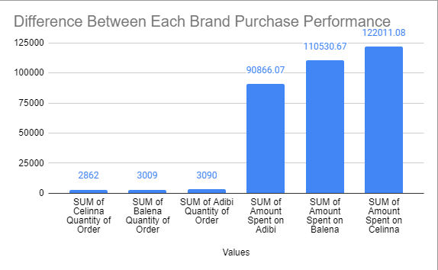
4. EDA
Question
Is there any difference in purchase performance between Adibi, Balena, & Celinna? Explain your insight based on the data.
(Insert Google Sheet Link specific page here)
Answer
We are using SUM to each brand of total amount spent and total quantity order using Pivot Table from that we know Purchase performance from each brand that :
Adibi has highest total quantity of Order
Celinna has lowest of total quantity of Order
Celinna has highest amount spent from each customer
Adibi has lowest amount Spent from each customer

Slide 13
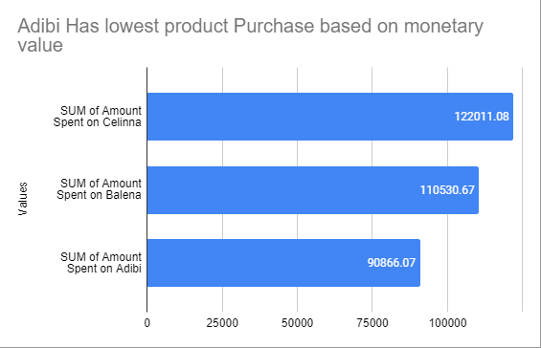
4. EDA
Question
B. Between Adibi, Balena, and Celinna, which brands have relatively lowest product purchased based on monetary value? (Hint: monetary value = value of order)
(Insert Google Sheet Link specific page here)
Answer
Between Adibi, Balena, and Celinna we use total SUM of Amount Spent on each brand base by customer and make a Pivot table and Bar Plot that we can conclude that Adibi has the lowest product purchased based by monetary value

Slide 14
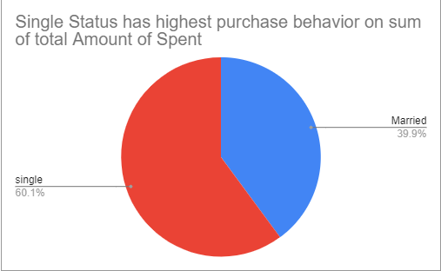
4. EDA
Question
C. What is the difference of purchase behavior between users who are married vs not married? (Hint: consider Pivot Table or XLMiner)
(Insert Google Sheet Link specific page here)
Answer
From data that we use Sum of Total amount spent by Married and single behavior using Pivot Table and Pie Chart between users who are Married and Not Married, we can conclude that highest buyer is from Single marital status which had 60.1% and 39.9% are married

Slide 15
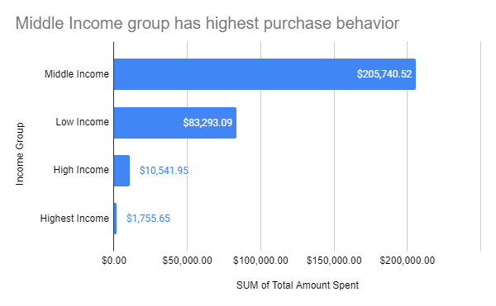
4. EDA
Question
D. What is the difference of purchase behavior between users based on their purchasing power? (Hint: use Income as grouping for your preference. For example: Income between 10k - 15k are low income, 15-25k are middle, etc.) (Insert Google Sheet Link specific page here)
Answer
By Income group that we know
<100.000 are low Income
100.000-200.000 are middle income
200.000-300.000 are high income
>300.000 are highest income
We can conclude that Middle Income people are more tend to buy our product on our ecommerce based by Total Amount Spent

Slide 16
4. EDA
Question
E. Based on point A-D what recommendation(s) can you provide? (Hint: you can connect it with previous business problem you stated in Milestone 1)
(Insert Google Sheet Link specific page here)
Answer
Based on information from EDA, we found insight that we need to focus on Celinna Brand campaign because Celinna has highest total Amount of Spent rather than Adibi and Balena, even though Adibi has paid us 80 million US dollars which highest fee ever paid to Luxura, but still our customer still choose Celinna as their favorite Brand based on Total Amount of Spent in last quarter of 2022.
We may also create some Couple product that may increase revenue and user growth from those who are married and we might focus on High Income and highest income Group as we should create Premium class Product that very limited as related to Adibi has paid huge fee to luxura so it would overcome Adibi increase Purchase Value and releasing Adibi new Premium product so we could increase our product value from those group.

Slide 17
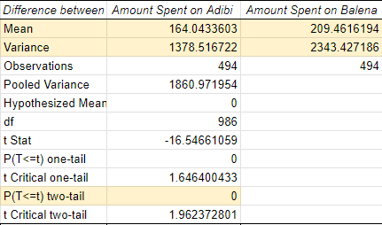
5. Hypothesis Testing
Question
Is there any significant difference between Adibi and Balena purchase value ?
(Insert Google Sheet Link specific page here)
Answer
From T-testing Two-sample Assuming equal variance that Between Adibi and Balena Purchase Value has Significant difference between those two brand by looking Mean and because P-value < Alpha threshold there is difference between Adibi and Balena Purchase Value
https://docs.google.com/spreadsheets/d/1GBEL6Gwa-K5rHSN4oRl1Sw3Hioik5ECUVYWYgl7RULA/edit#gid=1195953596

Slide 18
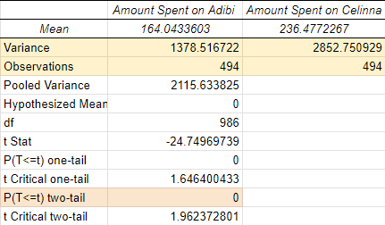
5. Hypothesis Testing
Question
B. Is there any significant difference between Adibi and Celinna purchase value?
(Insert Google Sheet Link specific page here)
Answer
From T-testing Two-sample Assuming equal variance that Between Adibi and Celinna Purchase Value has Significant difference between those two brand by looking Mean and because P-value < Alpha threshold there is huge difference between Adibi and Balena Purchase Value
https://docs.google.com/spreadsheets/d/1GBEL6Gwa-K5rHSN4oRl1Sw3Hioik5ECUVYWYgl7RULA/edit#gid=1195953596

Slide 19
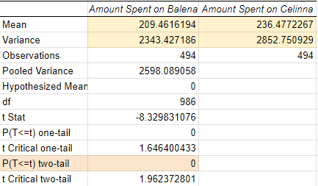
5. Hypothesis Testing
Question
C. Is there any significant difference between Balena and Celinna purchase value?
(Insert Google Sheet Link specific page here)
Answer
From T-testing Two-sample Assuming equal variance that Between Balena and Celinna Purchase Value has Significant difference between those two brand by looking Mean and because P-value < Alpha threshold there is huge difference between Balena and Celinna Purchase Value
https://docs.google.com/spreadsheets/d/1GBEL6Gwa-K5rHSN4oRl1Sw3Hioik5ECUVYWYgl7RULA/edit#gid=1195953596

Slide 20
5. Hypothesis Testing
Question
D. Based on the result on point A-C, what insights could you get?
(Insert Google Sheet Link specific page here)
Answer
Based on observation each brand has same value so we using t-testing two-sample assuming equal variance even variance not really had huge difference between those three brand
Based on calculations p-value is below 0.05 on each brand so each brand has significantly difference and we accept h1 hypotesting
Adibi and Celinna has huge gap that is proof which those two brand has significant difference even Balena-Adibi and Balena-Celinna not that huge gap but still has significant difference.
https://docs.google.com/spreadsheets/d/1GBEL6Gwa-K5rHSN4oRl1Sw3Hioik5ECUVYWYgl7RULA/edit#gid=1195953596

Slide 21
5. Hypothesis Testing
Question
E. Based on point D, what business recommendations could you provide?
(Insert Google Sheet Link specific page here)
Answer
Suggestion :
We can Overcome Adibi behind by making more Outfit Idea on Adibi Product and Market strategy on Adibi product since Adibi has paid Luxura 80 million US dollar this idea could increase Adibi Purchase value
Adibi should duplicate Celinna Idea and Strategy because Celinna Excellency Purchase Value value
Even Balena and Celinna Purchase value wasn’t a huge gap but still Balena could Study from Celinna Excellency
https://docs.google.com/spreadsheets/d/1GBEL6Gwa-K5rHSN4oRl1Sw3Hioik5ECUVYWYgl7RULA/edit#gid=1195953596

